Slide 1
GIG Development Schedule - 2020
Phase 1
GIG Landing Page update
Bonus amount on Top-up
Trial Pools
Phase 2 | Priority
Self Survey – Instant Win | 1
Pick 3C | 2
Timed Trivia | 3
Mobile App - Android | 4
Badge of Honour program | 5
Pick 3E | 6
Notification set by player | 7
Branded Pools | 8
Loyalty Program | 9
Special Phase | Priority
Team Fantasy Pool

Slide 2
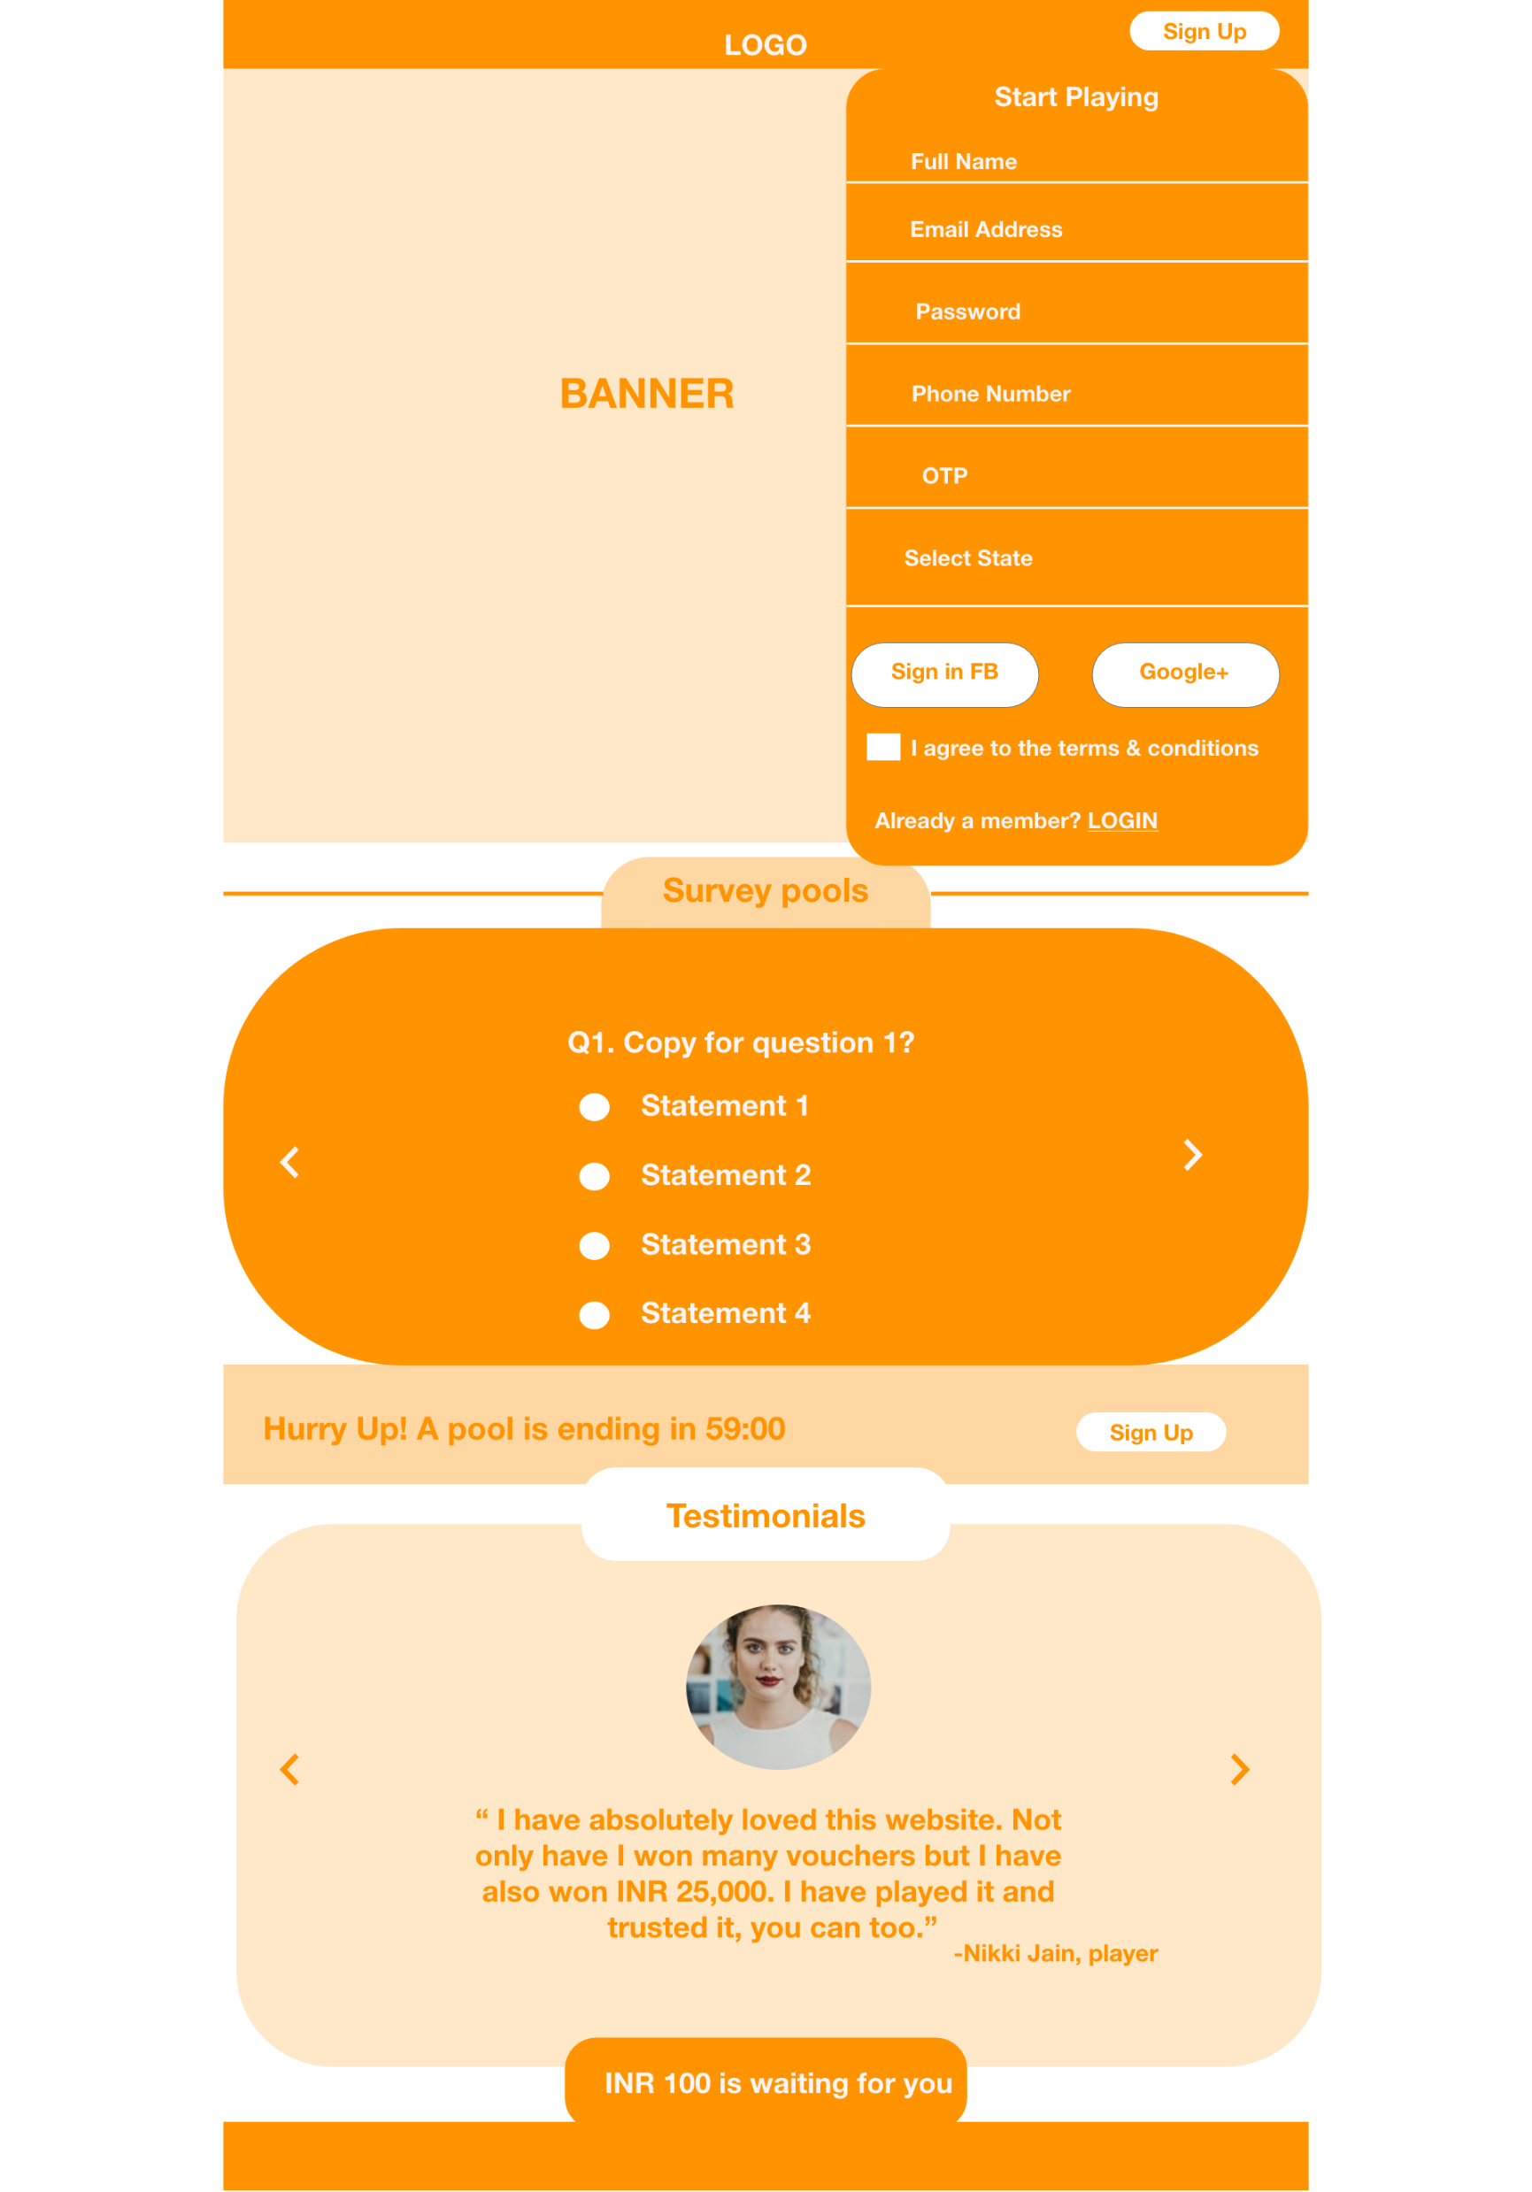
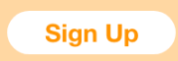
LOGIN
Home Page
Missing Screen Name
3 JPEG
Entertainment Pool
From system
Hyper Link
Hurry Up! A pool is ending in 00:00
6 JPEG
Click anywhere to go to next
Sports Pool
From System
Hurry Up! A pool is ending In 00:00
3 JPEG
Caracul
From the system
If deposit greater than XXX you receive bonus of YY

Slide 3
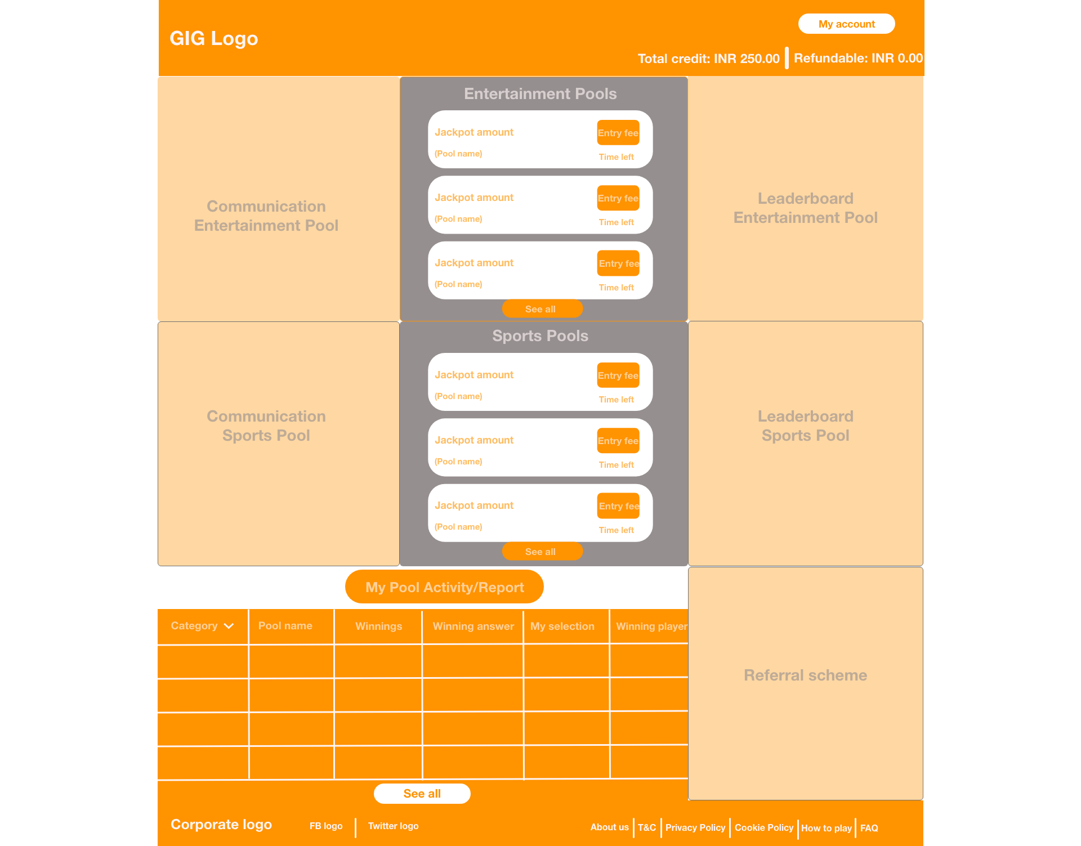
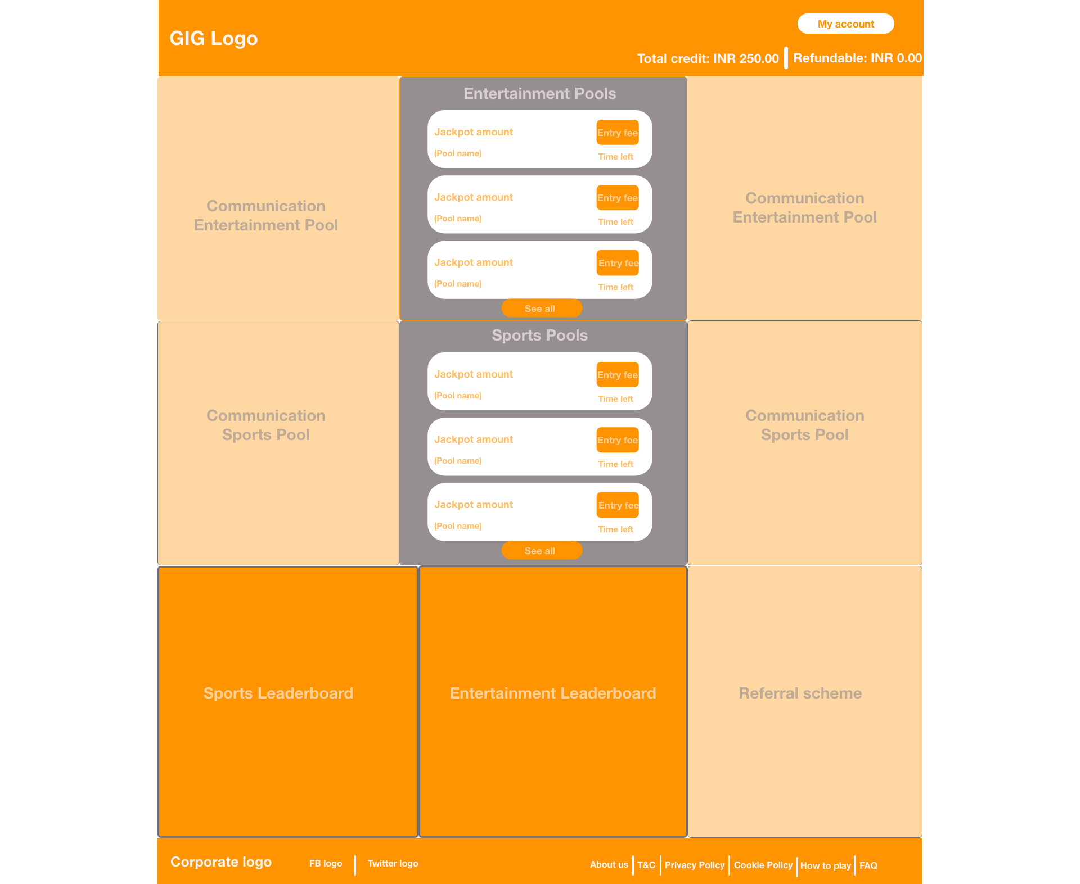
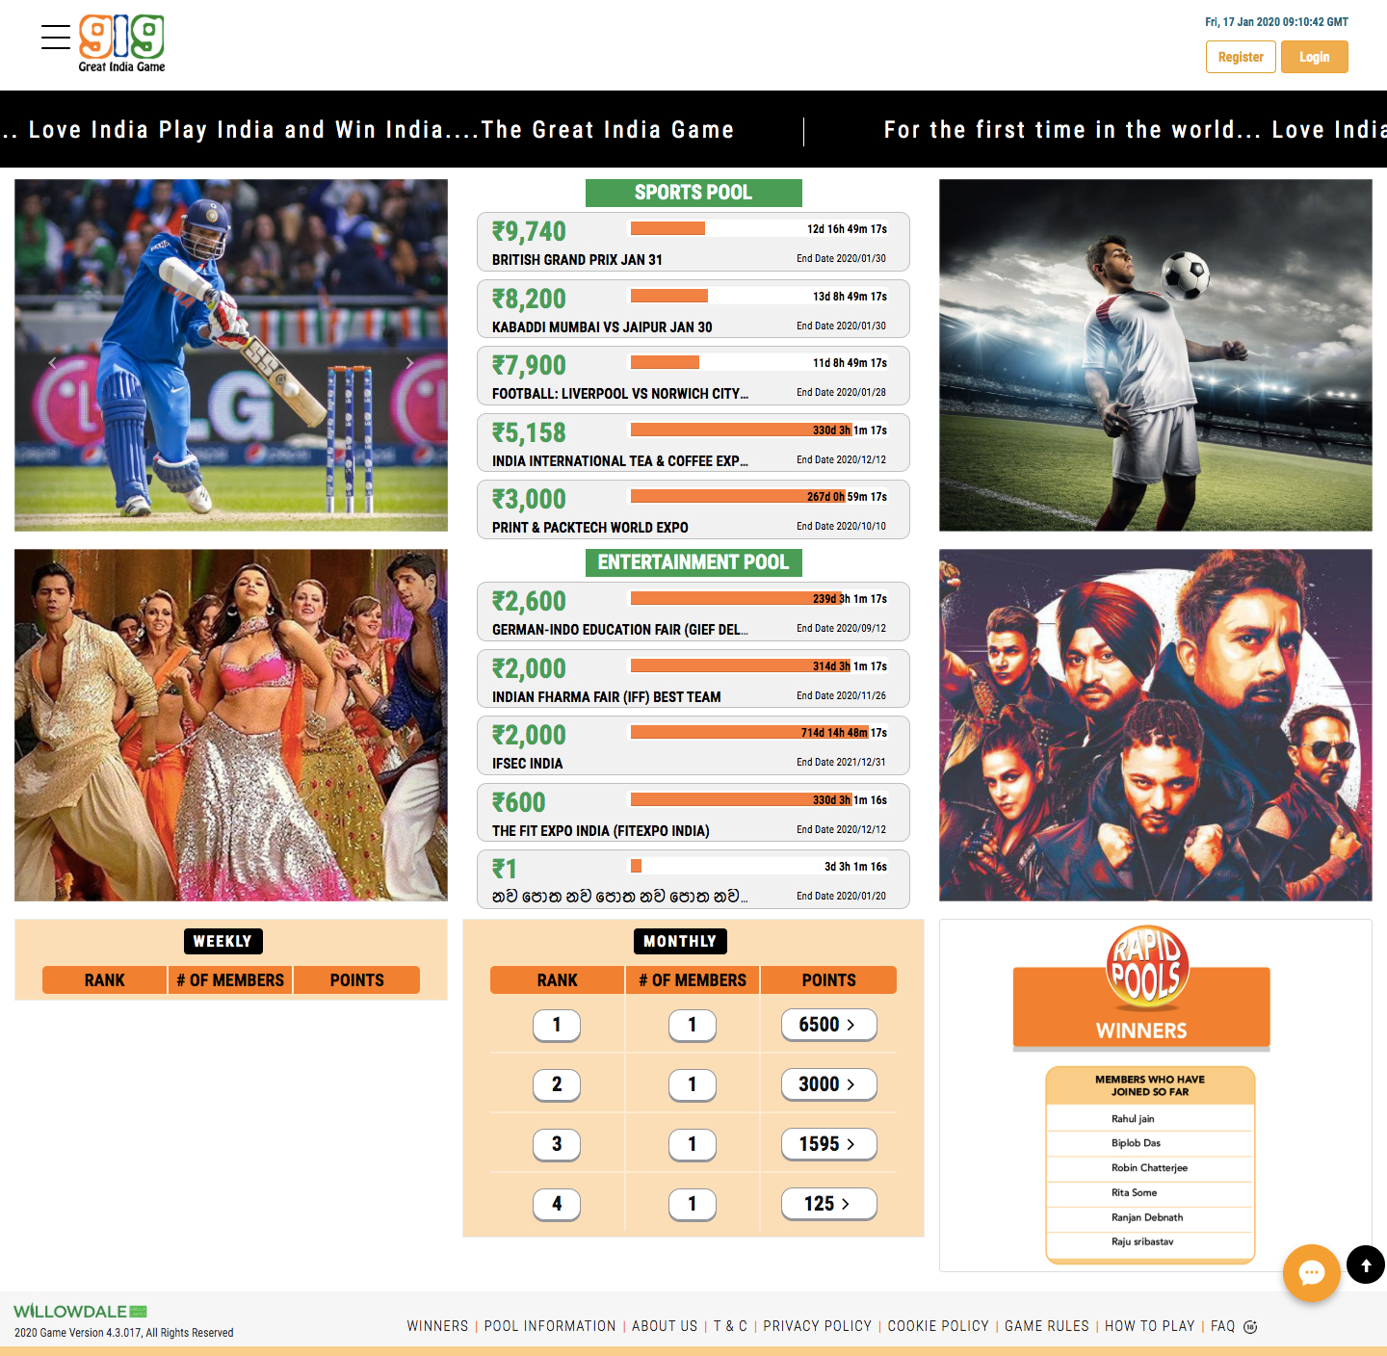
NO Hamburger
Ref. #
Date & Time
Main Page
NO TICKER
Communication
Entertainment
Leaderboards
Entrainment
Single Image
Trial Pools
Trial Pools
More
Single Image
Communication
Sports
Leaderboard
Sports
Trial Pools
Trial Pools
More
Single Image
Communication
Realtime pools
Realtime
Pools
Winner
Realtime Pools

Slide 4
NO Subscription & Bonus amount
Phase 1
THERE WILL BE NO SUBSCRIPTION. There will be Initial Deposit and Top-Up.
Player will get a bonus amount on their initial deposit (either a % of the deposit or a fixed amount).
Player will get a bonus amount (either a % of the deposit or a fixed amount) if they top-up with amount over a certain threshold.
This bonus will be in addition to any bonus they be entitled to under the Loyalty program.

Slide 5
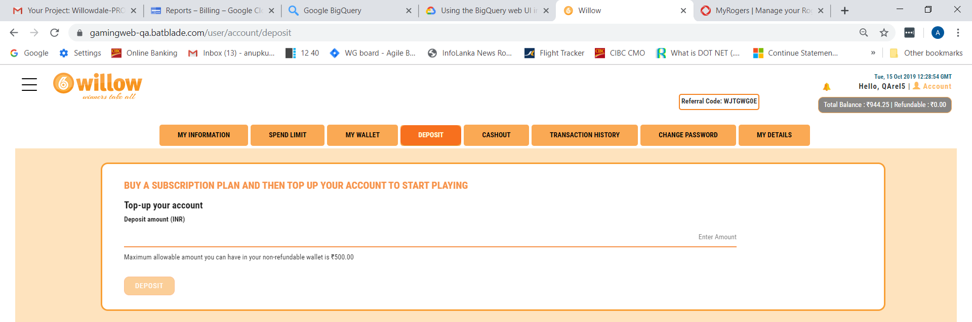
Phase 1
This will only display on Initial deposit
Minimum amount _____________ for Initial Deposit will earn ________ in Bonus.
Will display for top-ups
Any deposit over _______ will earn % of deposit amount or bonus amount of _______.

Slide 6
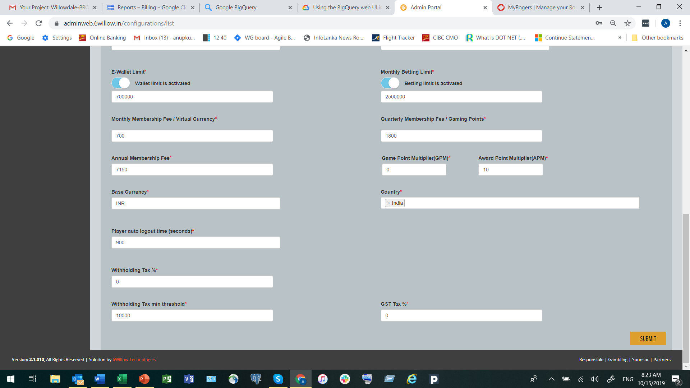
Phase 1
For each option allow one or the other option but not both. In/active button.
Min. Amount
Amt/% to add
Active
Initial Deposit
%
Top-up
F

Slide 7
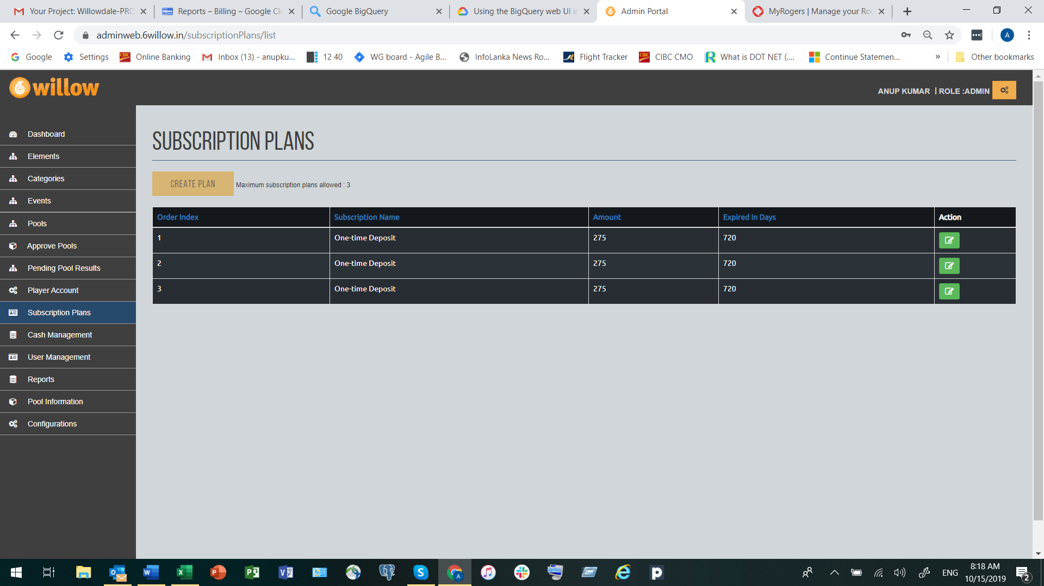
Phase 1
Bonus Amount per subscription
Active
Amt/% to add
%
F

Slide 8
Trial Pools
Phase 1
This feature will allow players to try out limited number of special pools before depositing any funds.
Option 1
Player will register on the site.
There only be 2 sports and 2 entertainment pools active at any given time.
After successful registration, player status will be set to Trial for 30 days.
System should allow pool with price point on Rs. 0. This means players can bet on this pool with no funds in their wallet.
Pools can be played by all Trial and Active players but not Inactive players.
Players cannot cashout unless they make the initial deposit and thus become an Active player.
If the player has not made a deposit within 30 days his player status will be set to Inactive.

